Slide 1
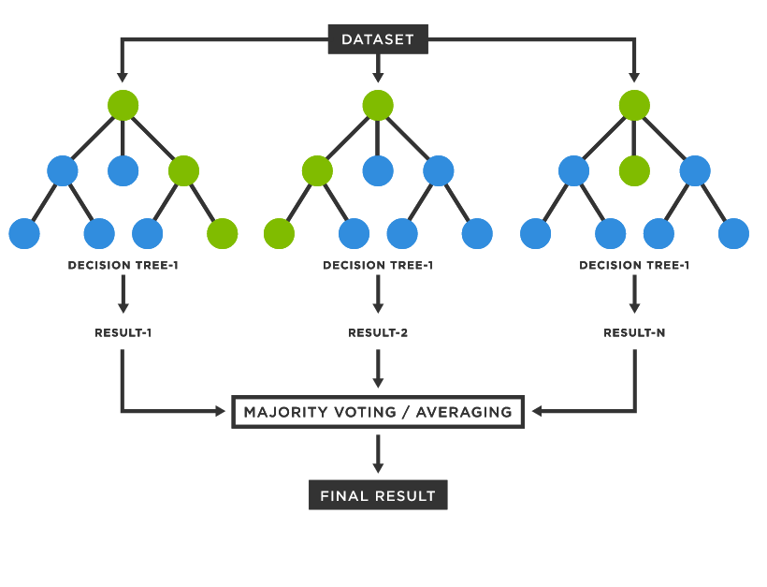
Random Forests
Sardorbek Zokirov

Slide 2
01
02
03
Agenda
Introduction
Information
Detailed information
What is Random Forest?
How it is performed?
Strengths and Weaknesses of the model
NEXT

Slide 3
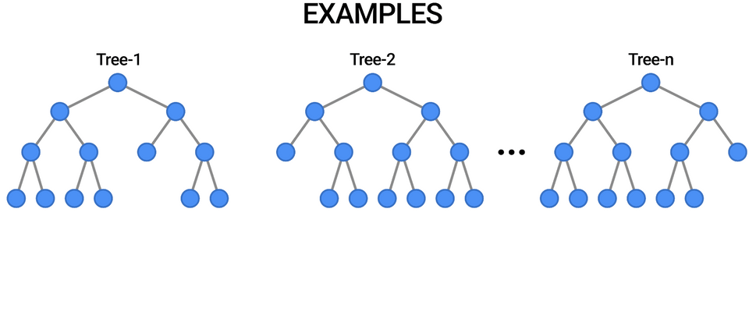
Random Forest is a supervised machine learning algorithm that consists of a large number of individual decision trees that operate as an ensemble. Each individual tree in the random forest gives a prediction and the model prediction is chosen based on this information.
In the case of classification problems, each individual tree’s result is considered and the result with the majority of the votes becomes the model’s prediction.
When we are doing regression problems, the model chooses the mean or mode of prediction of individual trees.
Random Forests
NEXT

Slide 4
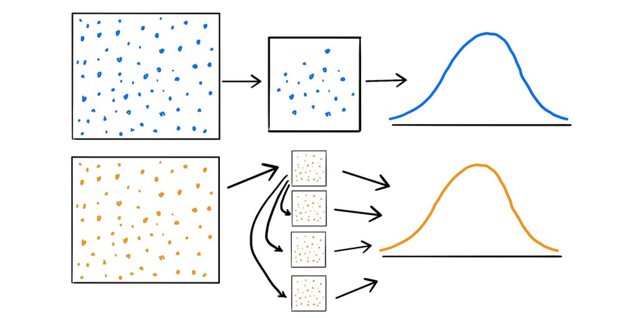
Bootstrapping
Random forests consist of many individual trees that are formed simultaneously and independently from each other. The reason why this is possible is that Random forests use bootstrapped data for each tree.
Bootstrapping is picking random samples from the original dataset with replacement. Bootstrapped data may have some duplicated data and may not include all the samples from the original dataset. It usually includes 60% of the original data. The size of bootstrapped data may be different from the dataset, but all bootstrapped sets need to have the same length.
Bootstrapping the data and using the aggregate to make a decision tree is called bagging. Random forests allow each individual tree to randomly sample from the dataset with replacement and results in different trees.
NEXT

Slide 5
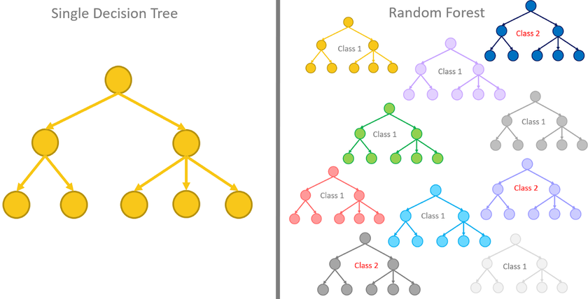
Random forests
is a very good and efficient model for working with large datasets. It is not prone to overfitting, mainly because a large number of relatively uncorrelated trees operating as a committee will work on making sure that predictions are accurate. The trees protect each other from their individual errors.
Strengths of Random forests:
An all-purpose model that performs well - both classification and regression;
It can handle noisy and missing data;
It can select only the most important features;
It model can be used efficiently with big datasets;
No feature scaling required: No feature scaling (standardization and normalization) required in case of Random Forest as it uses rule based approach instead of distance calculation.
Weaknesses:
It can be hard to interpret;
Requires the model to be tuned for the data with Cross-validation, GridSearchCV, etc;
Longer Training Period: Random Forest require much more time to train as compared to decision trees as it generates a lot of trees (instead of one tree in case of decision tree) and makes decision on the majority of votes.
NEXT

Slide 6
Thank you for your attention!

